Slide 1


Dr Jivraj Mehta Institute Of Technology
Event Management System
Internal Guide:- Submitted By:-
Mr. Mayur Ajmeri Bhadra Bhavesh 160820107001
Gor Bhavin 160820107005
Yadav Sandip 160820107039

Slide 2
INDEX
Introduction
Basis of project selection
Model used
Modules of Project
System Diagrams
Canvases
Screenshots of project
References

Slide 3
INTRODUCTION
The project Event Management System is very helpful for planning a successfully organized function.
The project gives basic functionality required for an event. It allows the customer to select from a list of event types. Then customer enters an event like Marriage, Dance Show etc, the system then allows the customer to select the date and time of event, place and the event equipment’s.
This system also useful for different kinds of events like games, workshops, and seminars.
It can help in maintain to keep record of participants and generate results for participants. This system provides planning and tracking of all the activities of event.

Slide 4
Basis of Project Selection
In the existing system , the person has to visit the particular office for enquiry.
The existing system’s process is quite complex and manual one.
The Event management system has to keep records of events manually.
It consumes lot of time of user.
Because of all these, we are making Event Management System
which is more efficient and less time consuming for user.

Slide 5
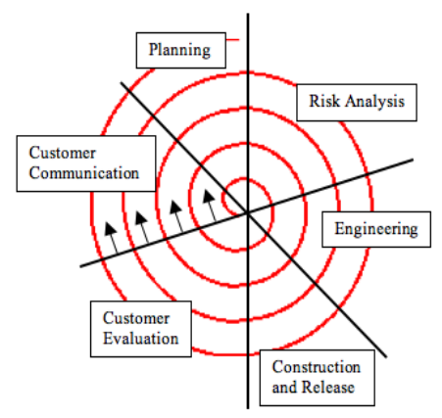
Model Used
Spiral Model

Slide 6
Planning: It includes estimating the cost, schedule and resources for the iteration. It also involves understanding the system requirements for continuous communication between the system analyst and the customer
Risk Analysis: Identification of potential risk is done while risk mitigation strategy is planned and finalized
Engineering: It includes testing, coding and deploying software at the customer site
Construction & Release: In this working model of the software called build is developed with a version number. These versions are sent to the users for feedback.
Customer Evaluation: Evaluation of software by the customer. Also, includes identifying and monitoring risks such as schedule slippage and cost overrun
Customer Communication: Based on the customer assessment, development process enters into the next iteration and afterwards follows the linear approach to implement the feedback provided by the user

Slide 7
Modules Of Project
Module 1: We are providing a online platform where user can easily organize an event successfully.
Module 2: Quick and easy registration for the User as well as administration & Event Manager.
Module 3: This System very efficiently store, maintain and retrieve data from it’s database and can be used for various features i.e. : providing latest notification to its user.

Slide 8
System Diagrams
There are Number of diagram drawn for “Event Management System” which are as follows.
E-R Diagram
Data flow Diagram ( Level 0,1,2 )
Sequence Diagram
Class Diagram
Use case Diagram
Activity Diagram

Slide 9
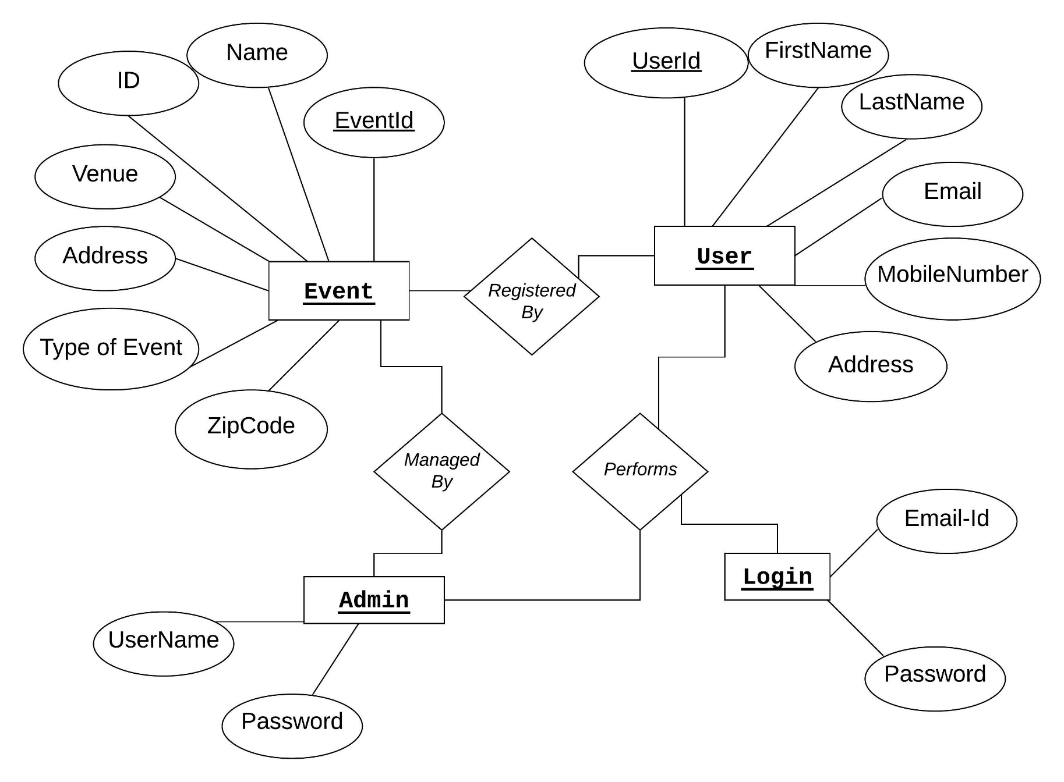
E-R Diagram

Slide 10
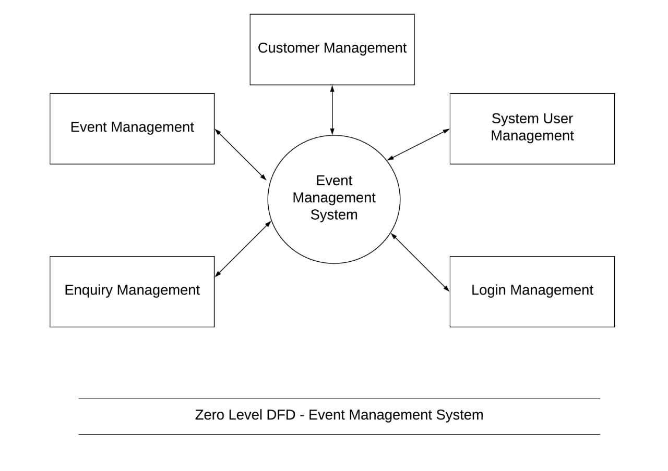
Data flow Diagram ( Level 0)

Slide 11
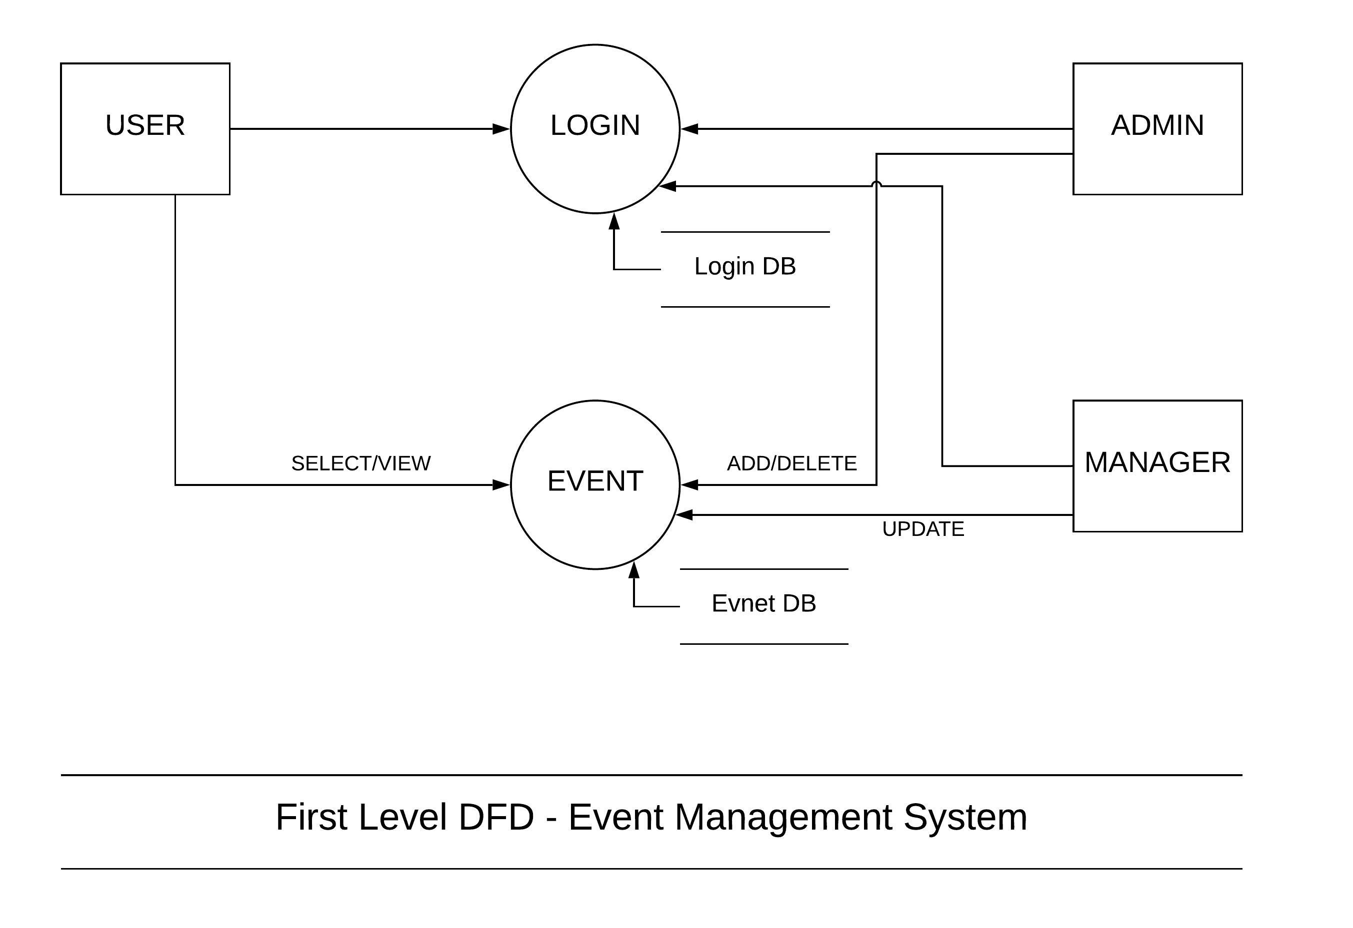
Data flow Diagram ( Level 1)

Slide 12
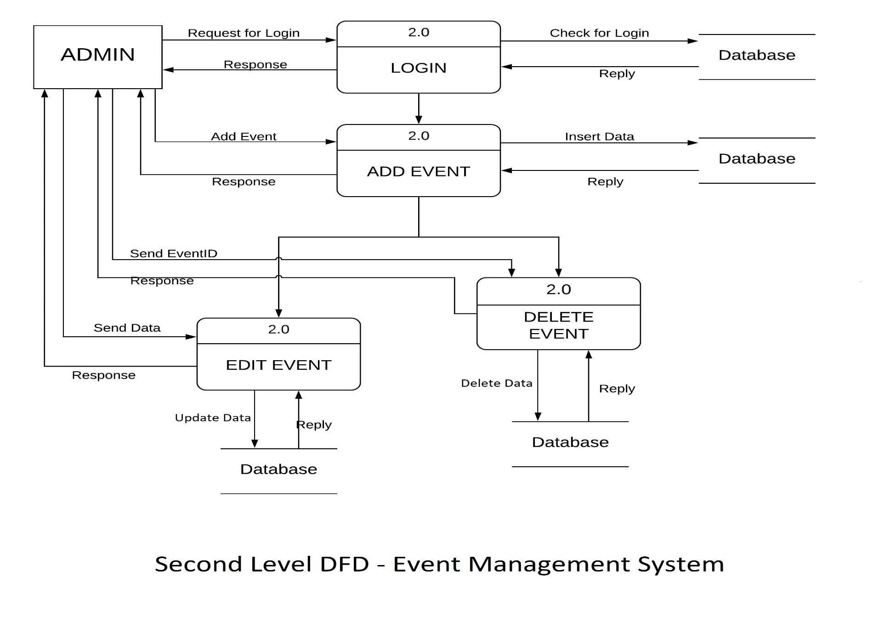
Data flow Diagram ( Level 2 )

Slide 13
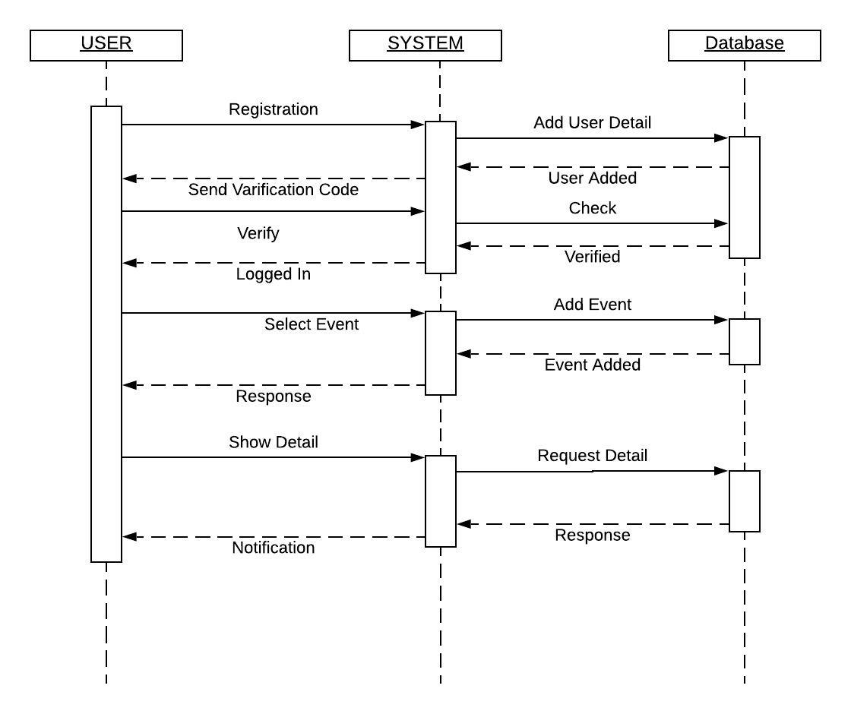
Sequence Diagram

Slide 14
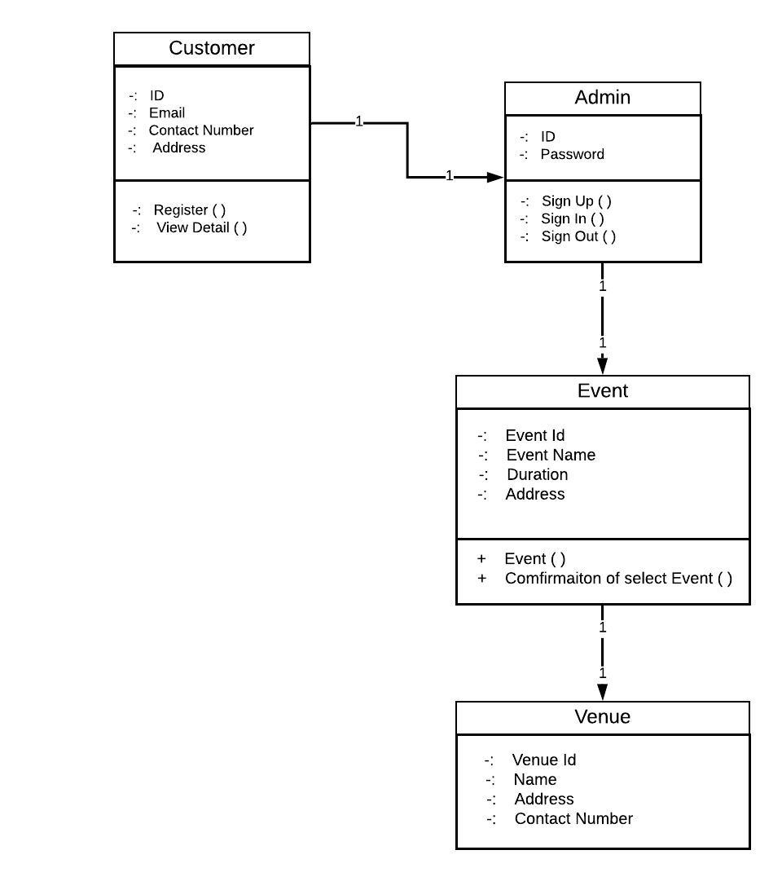
Class Diagram

Slide 15
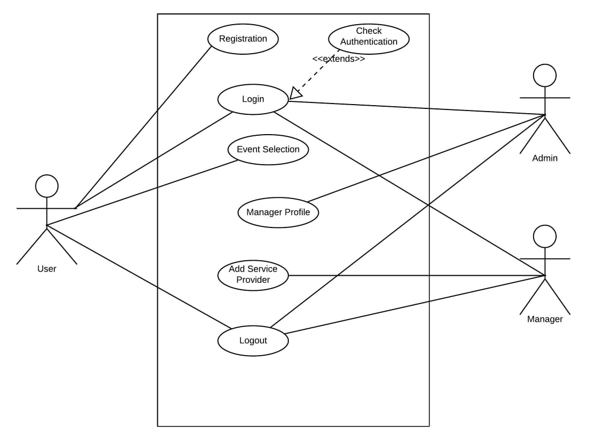
Use case Diagram

Slide 16
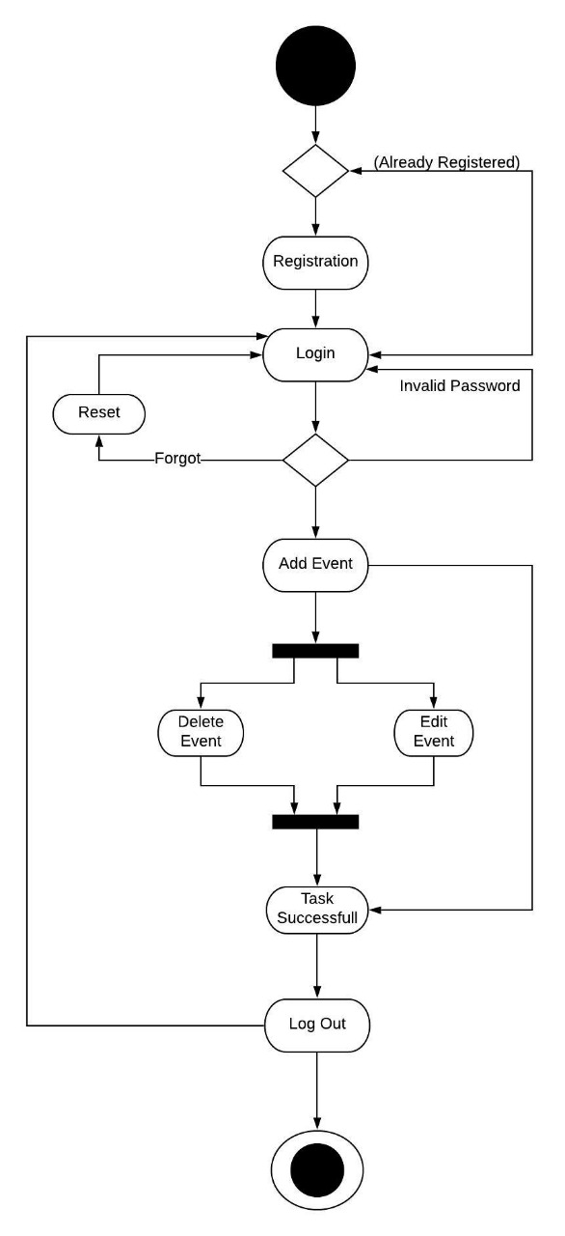
Activity Diagram

Slide 17
Screenshots Of project
There are Several Screenshots Available for “Event Management System”

Slide 18
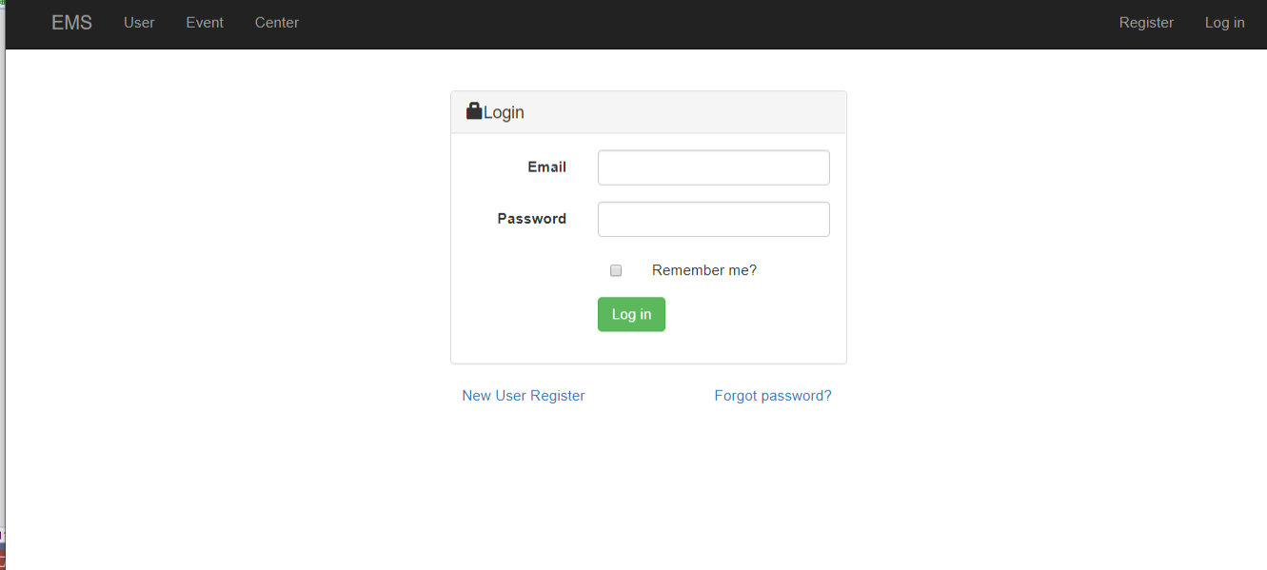

Slide 19
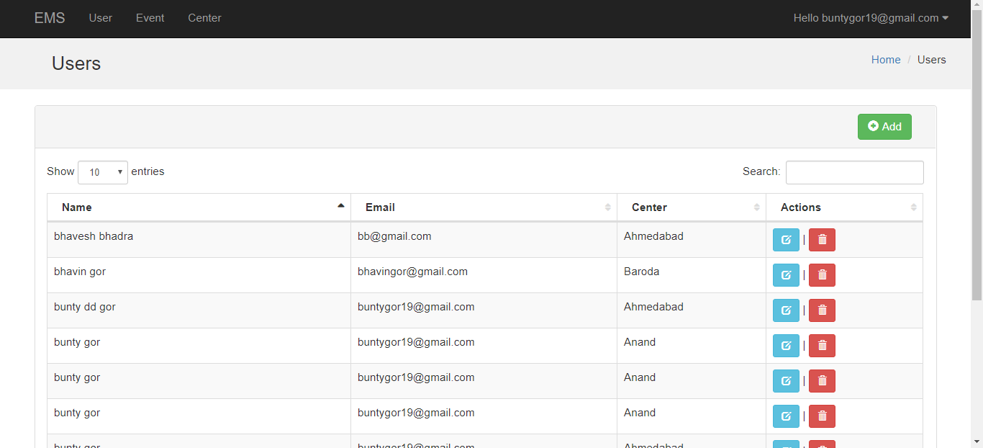

Slide 20
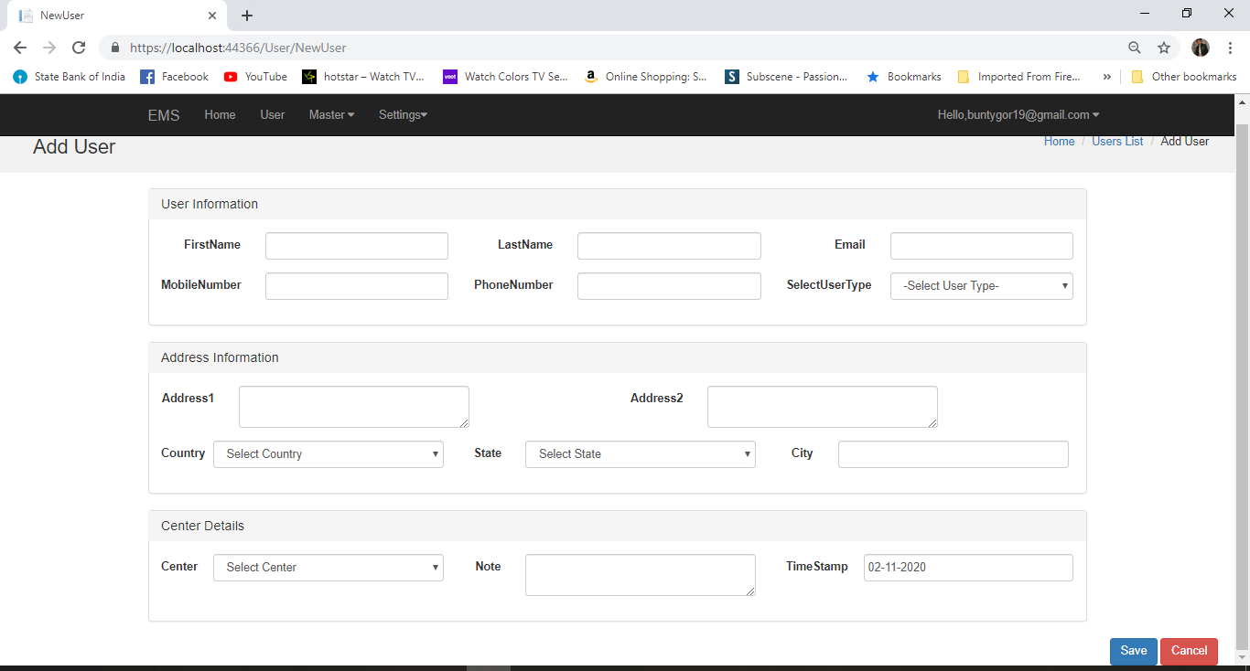

Slide 21
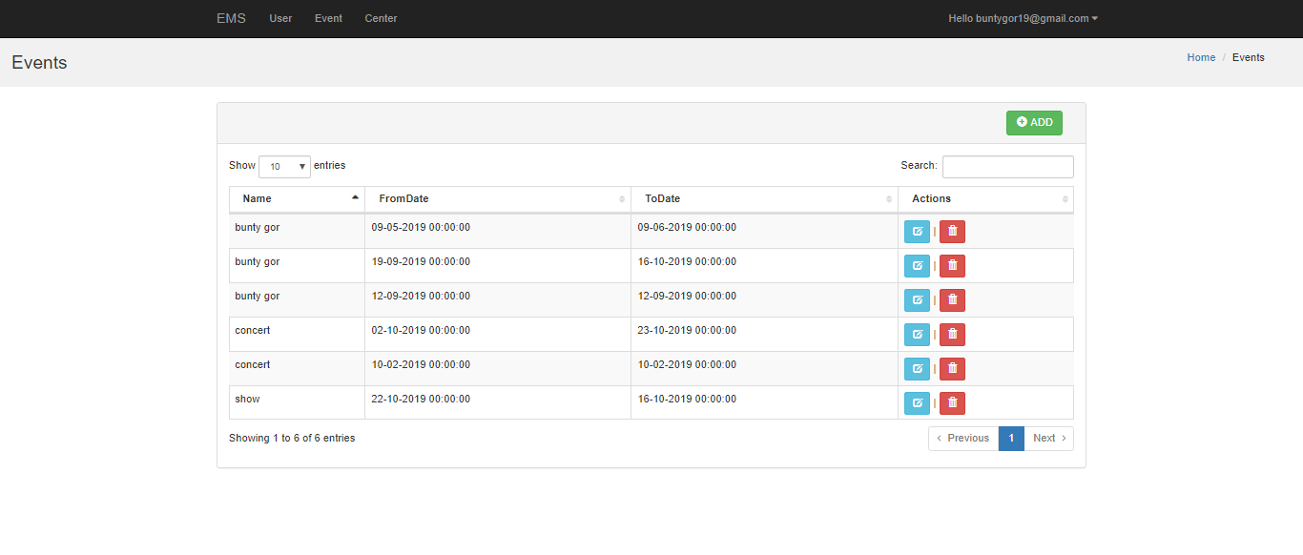

Slide 22
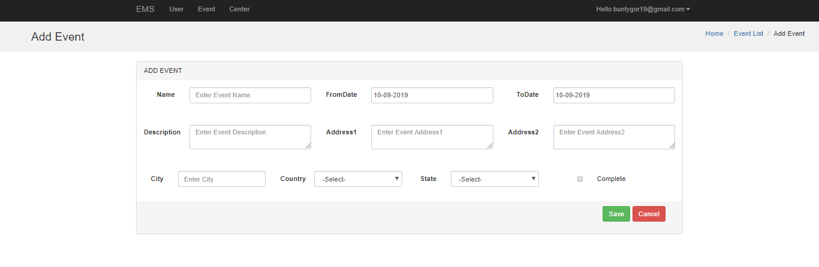

Slide 23
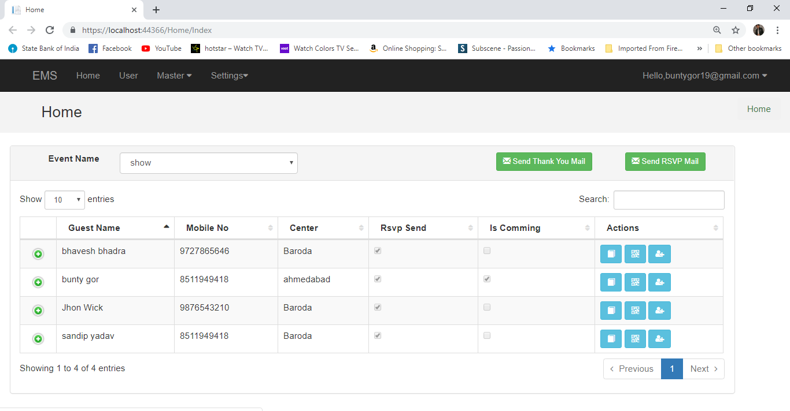

Slide 24
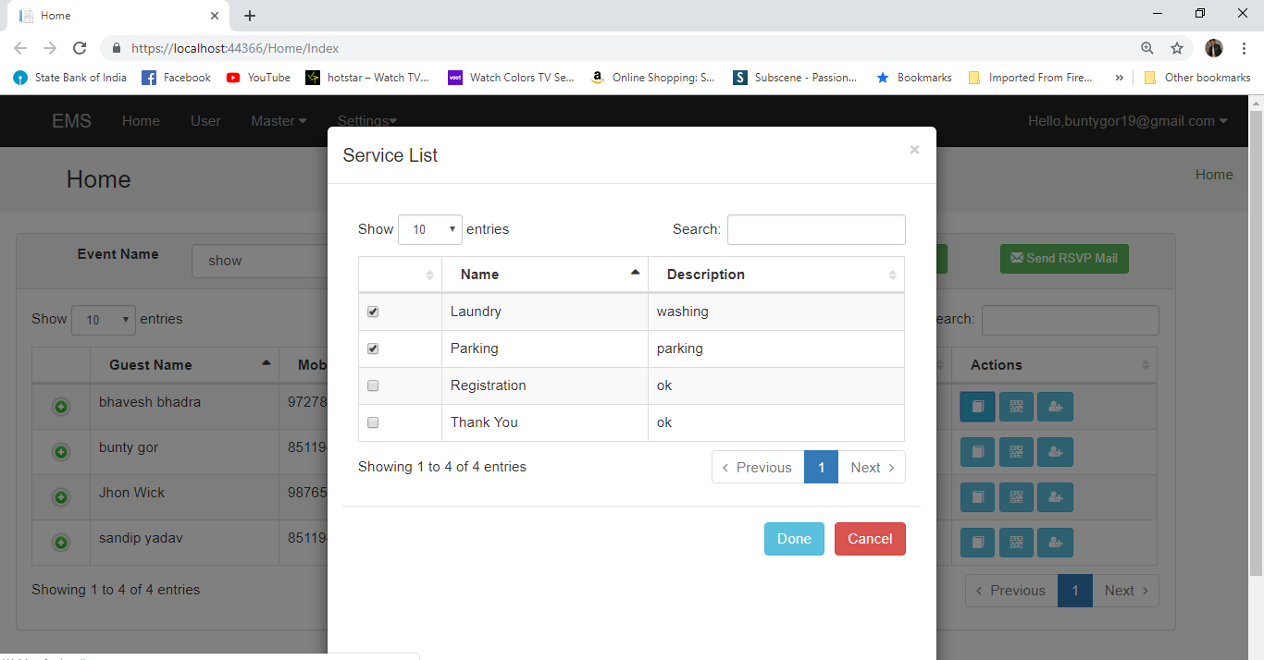

Slide 25
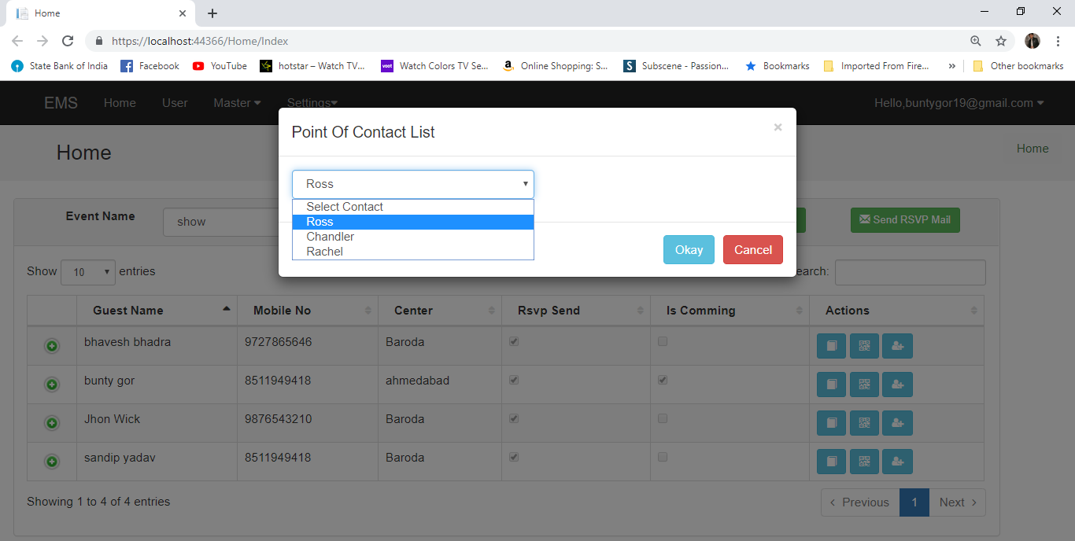

Slide 26
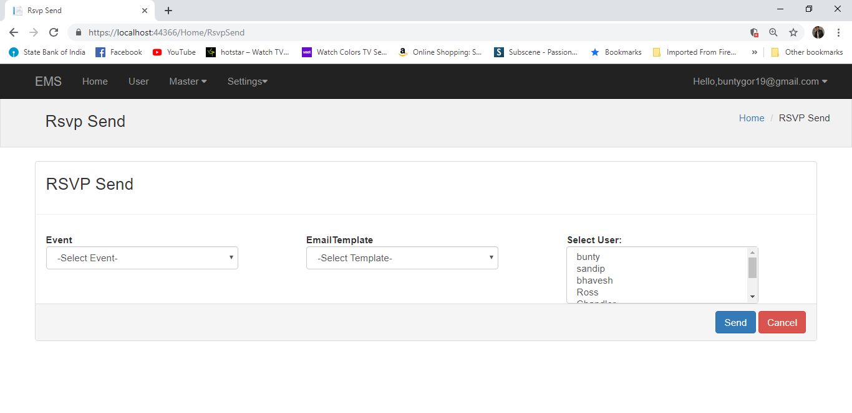

Slide 27
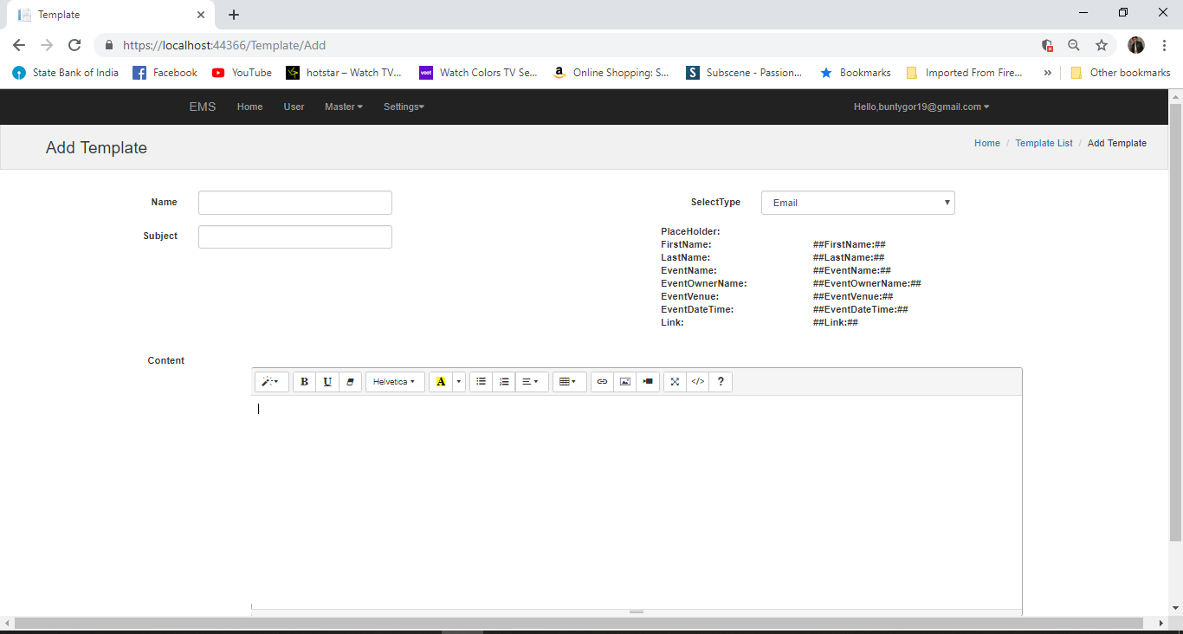

Slide 28
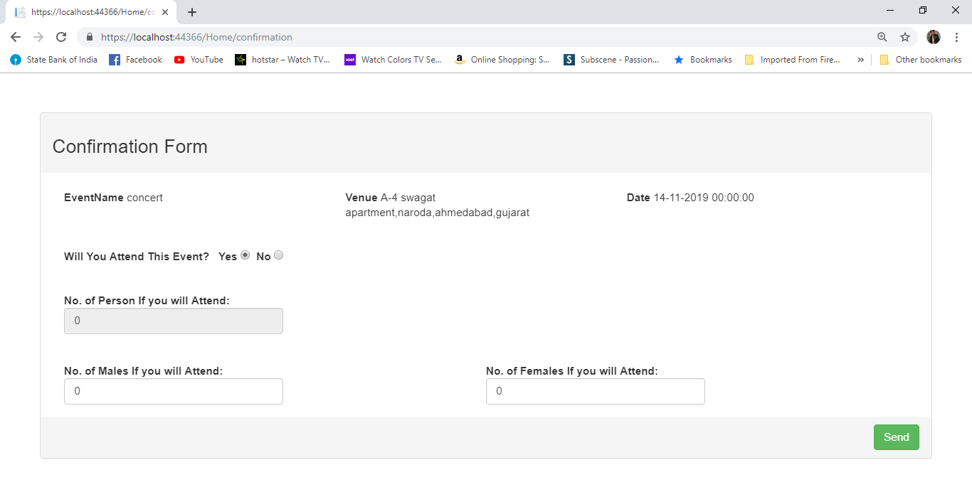

Slide 29
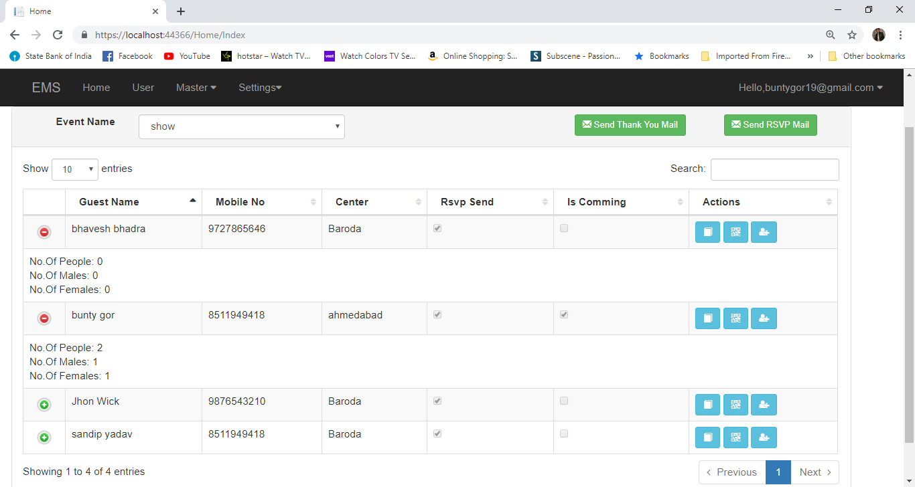

Slide 30


